Slide 1
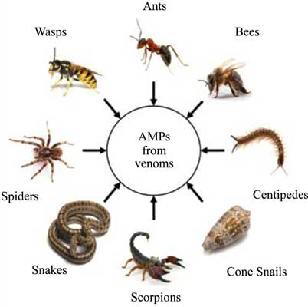
Toxicology course
Part 8:
Toxicology of animal poisoning
Notes:
AMP: animal peptides

Slide 2
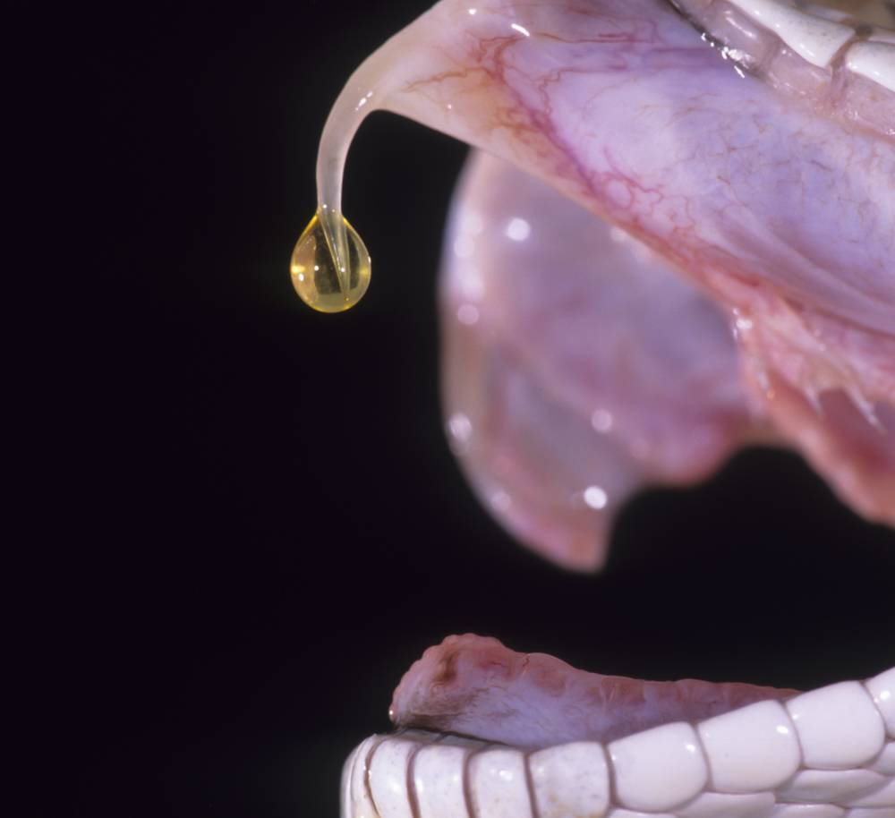
Definition
Venom is an animal poison contains different types of antigens as: (proteins enzymatic as protease, phosphodiesterases, hyaluronidases, phospholipase) .
Proteins toxics: acids amines, polypeptides. has to be injected into circulation.

Slide 3
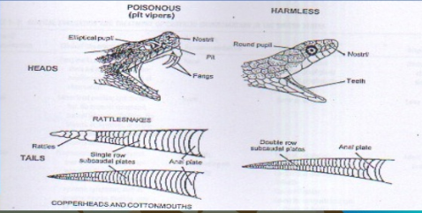
Snakes
Snakes are nocturnal reptiles & undergo hybridization, classified into:

Slide 4
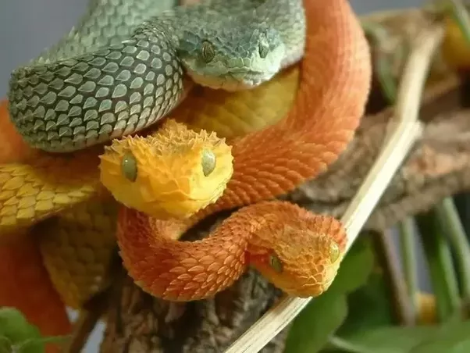
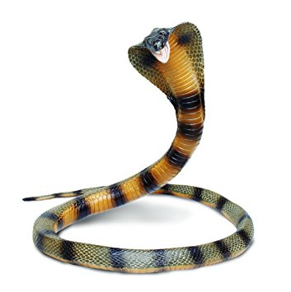
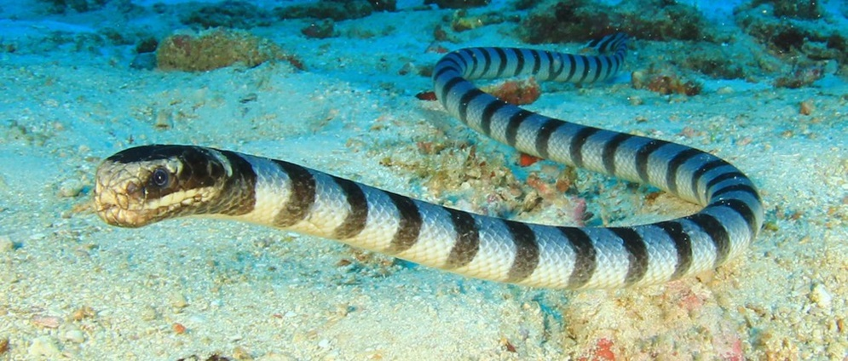
Classifications of snakes
According to the dominant venom:
Snake venom: Mixture of specific toxins (peptides& small proteins as hemotoxin, neurotoxin, cardio toxin, …) and spreading factors (enzymes as hyalourindase, phospholipase A, …)
Hemotoxic: vipers
Neurotoxic : cobra
Myotoxic : Sea snakes

Slide 5
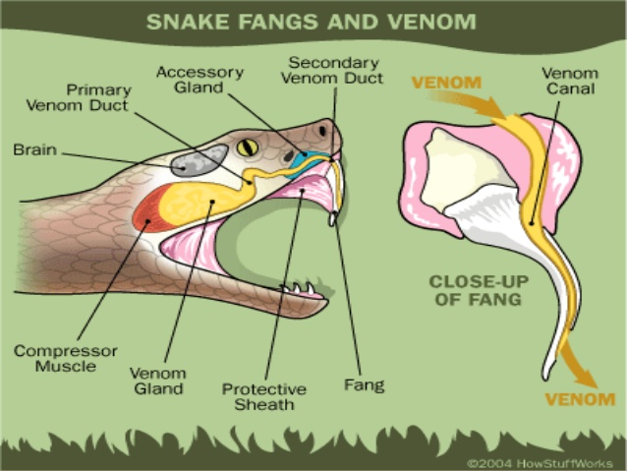
Neurotoxic venom:
Dominant in cobra venom
50-75% have low MW so, dialyzable
Act mainly on neuromuscular junctions -> weakness
dangerous when affect respiratory muscles -> respiratory failure.
Hemotoxic venom :
Dominant in viper snake venom
Have high MW so, not dialyzable
Mainly composed of hemolysin, thromboplastin, cardiotoxin
Can cause: hemolysis, destruction of vascular endothelium, cerebral and intestinal hemorrhage, hypotension & shock, and tissue necrosis.

Slide 6
Snake Venom composition
Snake venom consists of proteins, enzymes, substances with a cytotoxic effect, neurotoxins and coagulants.
Phosphodiesterases: are used to interfere with the prey's cardiac system, mainly to lower the blood pressure .
Phospholipase A2: causes hemolysis through esterolysis of red cell membranes and promotes muscle necrosis . Snake venom inhibits cholinesterase to make the prey lose muscle control.
Hyaluronidase: increases tissue permeability to increase the rate that other enzymes are absorbed into the prey's tissues.
Amino acid oxidases and proteases are used for digestion. Amino acid oxidase also triggers some other enzymes and is responsible for the yellow color of the venom of some species.
ATPases which are used for breaking down ATP to disrupt the prey's energy fuel use.

Slide 7
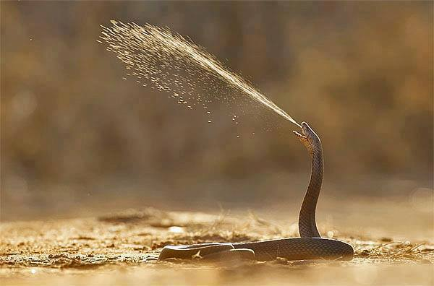
Spitting of the venom
is a defensive reaction
The snake tends to aim for the eyes of a perceived threat
a direct hit can cause temporary shock and blindness through severe inflammation of the cornea and conjunctiva.
While there are no serious results if the venom is washed away at once with plenty of water, the blindness caused by a successful spit can become permanent if left untreated.
Contact with the skin is not in itself dangerous, but open wounds may become envenomed.

Slide 8
Clinical Manifestations
The manifestations & severity of the case are depended on:
Amount of venom injected
Species of snake & nature of venom
Site of bite
Time of bite
Condition of fangs
Pathogens in mouth of snake
Death may occur immediately due to neurogenic shock

Slide 9
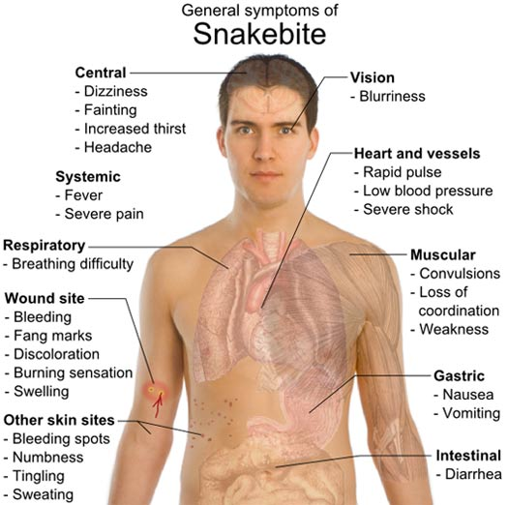

Slide 10
Neurotoxic Venom:
Start 15-45 minutes after biting
Local : fang mark (2 punctures), pain, redness, hotness, swelling,& may wet gangrene (generally less prominent than with hemotoxic venom)
Systemic : 1 st sign is ptosis & numbness in lips & tongue – giddiness – heaviness in bitted limb – salivation & vomiting – blurred vision – dysarthria – dysphagia – bradypnea – convulsions – coma & death due to resparatory failure

Slide 11
Hemotoxic Venom:
Local : prominent and include: fang marks, severe pain, redness, ecchymosis, hotness, edema and swelling of affected limb & dry gangrene
Systemic : nausea, vomiting – hypotension with rapid weak pulse – bleeding from mucous membranes – acute renal failure due to hemoglobinuria – coma and death due to circulatory collapse

Slide 12
Management of toxicity
Reassurance of patient is important
First step is to examine the site of bite and decide if the bite is poisonous or not to avoid unnecessary use of polyantivenom as it is risky and expensive
Immobilize the affected limb
Stop venom absorption as possible using tourniquet proximal to bite (just enough to obstruct lymph drainage not venous drainage) and make 2 small incisions over fang marks, and suction
Don’t use ice fomentations to avoid gangrene or give aspirin to avoid bleeding

Slide 13
Supportive Treatment:
Open IV line and correct fluid, electrolytes and acid-base balances
In all cases of snake bite either poisonous or nonpoisonous, we have to give broad spectrum antibiotics and anti-tetanic serum owing to pathogens found in snake mouth

Slide 14
Specific treatment :
Antivenoms can be classified into:
Monovalent (when they are effective against a given species' venom)
Polyvalent (when they are effective against a range of species, or several different species at the same time).
Indication:
envenominated bite with systemic manifestations.
Dose : depends on severity of bite not age or body size so a pediatric dose equal an adult dose:
mild give 3-5 vials
moderate give 5-10 vials
severe cases give 10 vials & maintain with more vials according to situation

Slide 15
Antivenoms are purified by several processes but will still contain other serum proteins that can act as antigens .
Some individuals may react to the antivenom with an immediate hypersensitivity reaction ( anaphylaxis ) or a delayed hypersensitivity ( serum sickness ) reaction and antivenom should, therefore, be used with caution.
Despite this caution, antivenom is typically the sole effective treatment for a life-threatening condition
the side effects are manageable, and antivenom should be given as rapidly as the side effects can be managed.

Slide 16
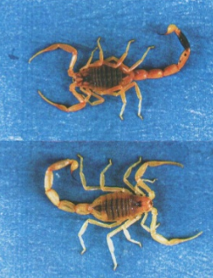
SCORPIONS
Belong to Arthropods
all of them are poisonous & their venoms are more potent than that of snakes & numerically more than snakes, so they represent more public health problem especially in southern areas
Generally, more dangerous & causing more morbidity & mortality in children.
Ex: Androctonus amoreuxi

Slide 17
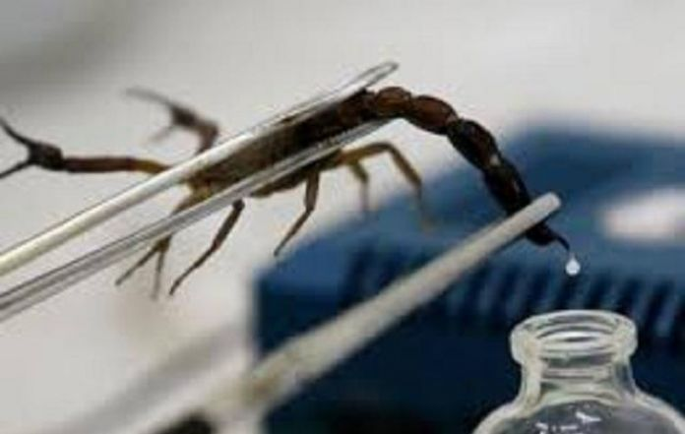
Scorpion Venom
Generally more toxic, more variability of specific toxins & more multiplicity of antigens than snake venom
Consists of amino acids, peptides & small proteins (mainly neurotoxin , nephrotoxin, cardiotoxin, hemolytic toxin, histamine, serotonin, anti-ACh-esterase) & enzymes as phospholipases, hyaluronidases, phosphodiesterase.
Inject able LD: few up to 50 μ g
Human have unique variable susceptibility to scorpion venom

Slide 18
Toxic Mechanism of Scorpion Venom
Neurotoxin:
Block voltage-gated Na+ & Ca++ channels….prolonged action potential & excessive release of catecholamine…..adrenergic manifestations
The long-chain polypeptide neurotoxin causes stabilization of voltage-dependent sodium channels in the open position, leading to continuous, prolonged, repetitive firing of the somatic, sympathetic, and parasympathetic neurons. This repetitive firing results in autonomic and neuromuscular over-excitation symptoms, and it prevents normal nerve impulse transmissions

Slide 19
the short polypeptide neurotoxin blocks the potassium channels.
Anti-cholinesterase….. accumulation of Ach…..cholinergic manifestations…….this will lead to marked CV effects
Autonomic excitation leads to cardiopulmonary effects observed after some scorpion envenomations.
Somatic and cranial nerve hyperactivity results from neuromuscular overstimulation.
Serotonin may be found in scorpion venom and is thought to contribute to the pain associated with scorpion envenomation.
A smaller child, a lower body weight, and a larger ratio of venom to body weight lead to a more severe reaction

Slide 20
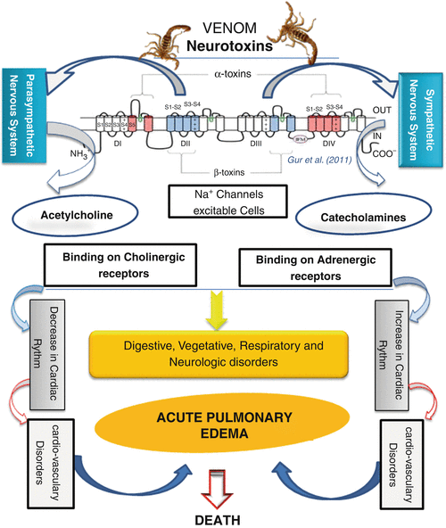

Slide 21
Factors Affecting Severity of Scorpion Sting
Age & body size of the victim
Species & size of scorpion
The amount of venom injected
Site & number of stings
Individual susceptibility to venom

Slide 22
Clinical Manifestations
Local: severe intense pain, edema, numbness & tenderness.
CVS: sinus arrhythmias, hypertension, pulmonary edema, ischemic changes in ECG, complications are more in children with increased LDH & CPK.
CNS : agitation, paresthesia ,irritability & (restlessness, severe involuntary shaking &jerking extremity due to somatic skeletal neuromuscular dysfunction). cerebral edema -> convulsions & coma
Others: nausea & vomiting, hypothermia , blurring of vision, tongue fasciculation slurred speech, diaphoresis, tearing

Slide 23
Management of Scorpion Sting
First aid: like snake but, it is mandatory to control local pain (use local anaesthesia) to make the patient calm which is very important procedure in management
Specific treatment: use polyantivenom as in snake
Supportive treatment:
support CV functions to avoid complications
Symptomatic treatment: use Haloperidol to control agitation.use diazepam in convulsions .use diuretics in pulmonary edema

Slide 24
Don't attempt to cut the wound and suck out the poison. This can cause infection or transfer the venom into the bloodstream of the person attempting to remove the poison.
Scorpions cannot usually deliver enough venom to kill a healthy adult. While venom toxicity varies among species, some scorpions contain very powerful neurotoxins, which, ounce for ounce, are more toxic to humans than the venom of cobras. However, scorpions inject relatively small amounts of venom (compared to snakes), so the overall dose of toxins per sting is survivable.

Slide 25
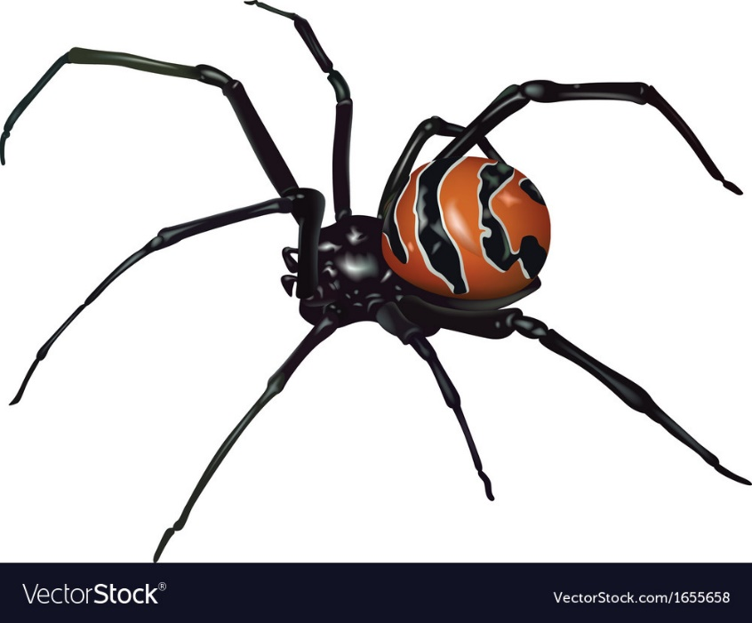
Black widow spider
Belong to Arthropods
Only female bite is clinically significant
identified by a red to orange hour-glass on the thorax
contains a potent neurotoxin which destroy cholinergic nerve terminals with massive release of A Ch especially at motor end plates causing severe muscle spasm & also, affect adrenergic nerve terminals that may cause increase in sympathetic outflow

Slide 26
Clinical Manifestations
Local: bite usually painless & local reaction is very rare in the form of pain, redness, edema & itching
Systemic: develop 1-3 hours ranging from mild affection to serious troubles & mostly in the form of severe muscle spasm leading to chest & abdominal pain, tremors & muscle fasciculation followed by muscle weakness – hypertension – nausea, vomiting & salivation

Slide 27
Management of Spider Bite
IV calcium gluconate which control pain and abdominal cramps & considered as antidote.
Latrodectus antivenin
Diazepam
Methocarbamol
Opioid analgesics
The antivenin is reserved for patient with severe cramps refractory to other therapy because it is an equine antivenin & may cause severe hypersensitivity and should be given very carefully with close patient observation

